Slide 1
Wan’s Part
8:00 a.m. – 8:45 a.m. Room 146A, WEWCC
Saturday 11/23

Slide 2
Latin: Magister
Teacher
Chinese Teacher of Odle Middle School, WA
Vice President of Chinese Language Teachers Association, WA

Slide 3
Bring Magic to Classroom
Magic via Effective Classroom Management
Magic via Engaging Classroom Activities

Slide 4
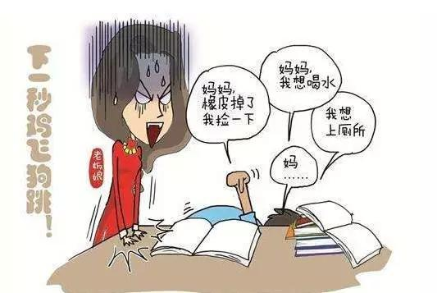
得 dei3 must ,have to
Magic through
Engaging Classroom
Activities

Slide 5
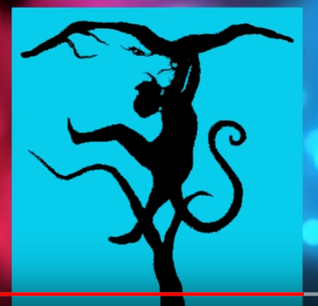
Bring Magic to Classroom: Engaging Classroom Activities
女孩 还是 地图？
Girl or Map
狮子 还是 猴子？
Lion or Monkey

Slide 6
Work with your table partners and find animals.

Slide 8
Poison dú yào
At the end of this game: Who lives longer?
Four people together.
Before the game starts, 3 students decide secretly which block is the poison. Don’t tell the player.
The player reads the blocks in any order.
When the player reads the poisoned block, the other 3 people will say 你死了nǐ sǐ le You were dead!
Take turns

Slide 9
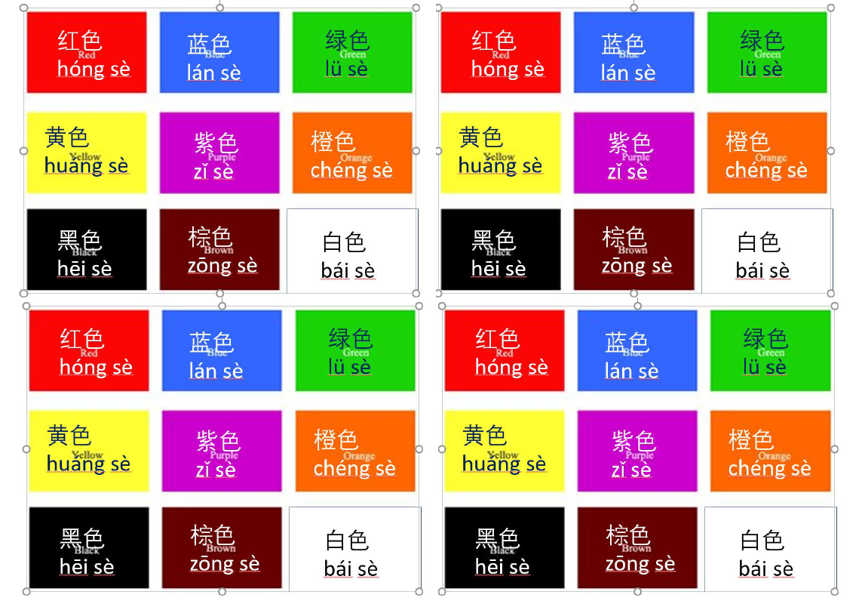

Slide 10
Relate to real life/ Add Critical Thinking to Class
Curiosity to the world《台湾学生在日本高中》
https://www.youtube.com/watch?v=IfI_Gom2jjQ&t=31s
台湾的校园和日本的校园有什么不同？美国的校园和日本的校园有什么不同？如果你去日本读书，你会在哪些方面适应得比较快？
What is the difference between campus in Taiwan and Japan, between US and Japan? If you study in Japan, do you think you will adapt to the new situation quickly? Why?

Slide 11
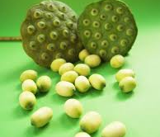
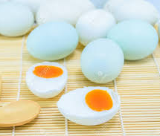
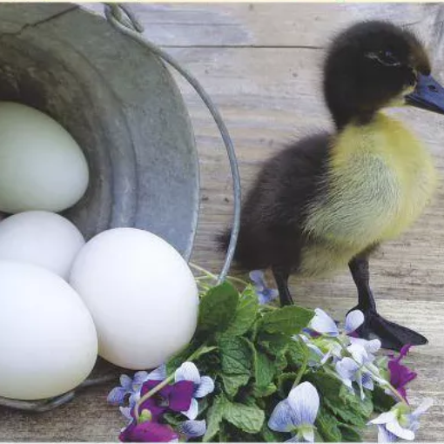
Magic Mooncake
https://www.youtube.com/watch?v=wchuCzd8oKA
盐 salt
咸鸭蛋 salty preserved duck egg
蛋黄 yolk
莲子 lotus seed
莲蓉 Lotus paste

Slide 12
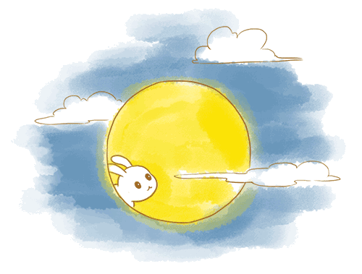
Mid-autumn Festival

Slide 13
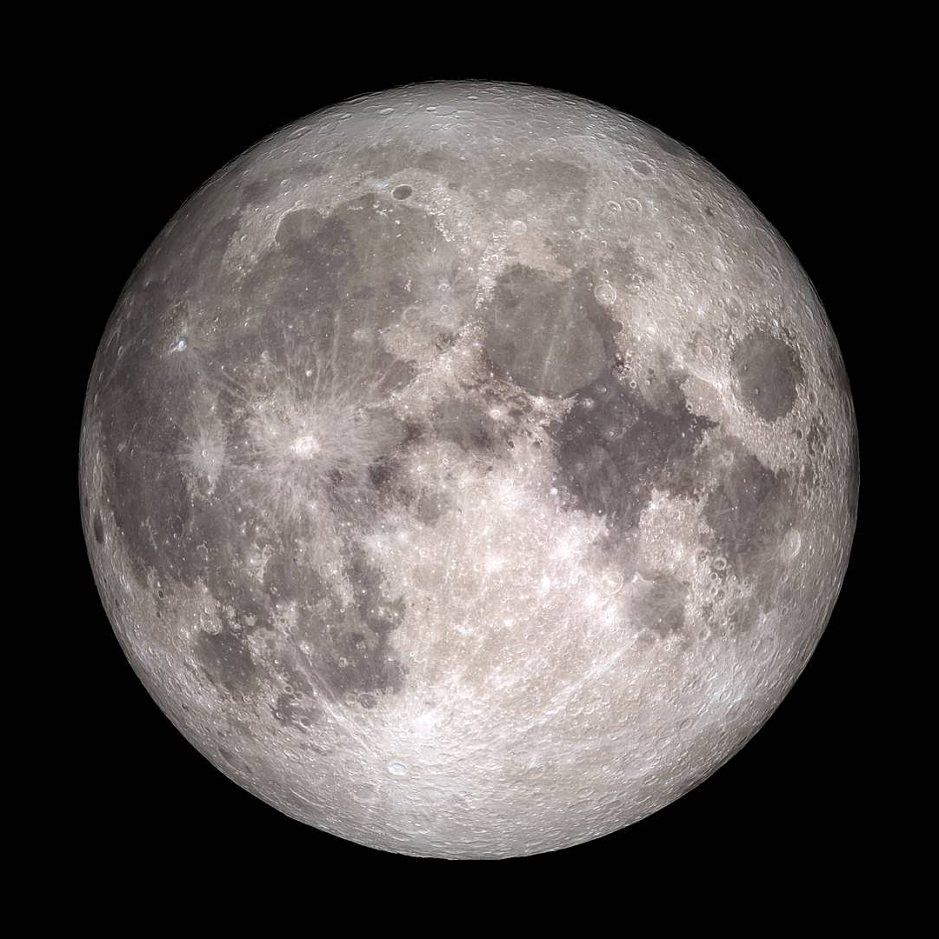

Slide 14
Jade Rabbit

Slide 15
STEM: Self-Rotated Earth-Moon Model
AA Battery
Foam Ball
Copper Wire
5-6 Disc Magnet

Slide 16
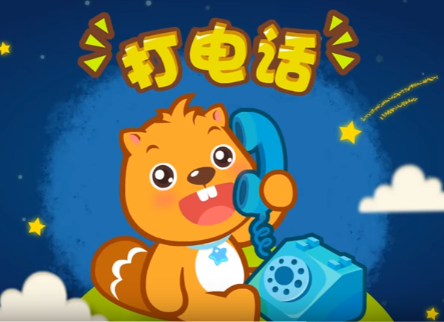
Write a New Nursery song:
Making a Phone Call
https://www.youtube.com/watch?v=TmwKfTKoYi4

Slide 17
Work in your table and sing together 5 sets:
1 set of your own
One set
3 sets

Slide 18
Questions
Jingran Wan：wanji@bsd405.org

