Slide 1
Quick Overview of the IB Program
Prepared for CLTA-WA
June 3, 2017
Hong Jiang

Slide 2
The IB Continuum
PYP: Primary Year Program- elementary schools
MYP: Middle Year Program –
11-16 岁 (middle schools and/or
first 2 years of high school)
DP: Diploma Program –
last 2 years of high school （16-19岁）

Slide 3
The IB Learner Profile （IB学习者：我们应该把学生培养成什么样的人）
Inquirers
Knowledgeable
Thinkers
Communicators
Principled
Open-minded
Caring
Risk-takers
Balanced
Reflective

Slide 4
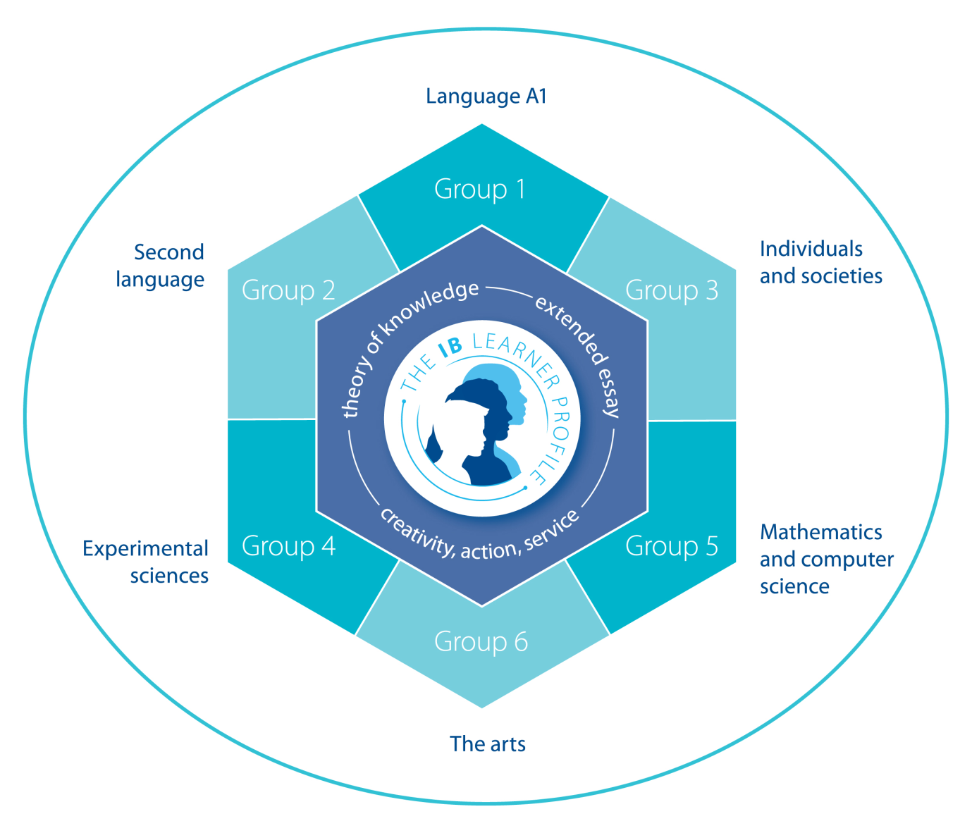
Diploma Programme Curriculum 6 subject groups and a core of 3 parts.
3 subjects in SL
3 subjects in HL
4000-word Extended Essay
150 hours of CAS (creativity, action, service)
100 hours of TOK over 2 years

Slide 5
Principles of Course Design
No prescribed textbooks
Range of texts linked to one or more topics
Authentic material
Variety, integration, whole-class projects, learning beyond the classroom, transparency and personal development
A TWO YEAR COURSE

Slide 6
Curriculum: 3 Core Themes and 5 Optional Themes

Slide 7
An Example: Core-3: Global Issues
Drugs
Energy reserves
Food and water
Climate change
Natural disasters
Globalization
Migration
Pandemics
Poverty and famine
Racism, prejudice and discrimination
The effect of man on nature
The environment and sustainability

Slide 8
A Sample Activity to study Stereotypes
农民工
年龄：
种族/民族：
相貌衣着：
社会地位：
经济收入：
爱好/追求：
受教育程度：
宗教信仰：

Slide 9
Let’s Try the Activity: Pair Work
1. Pass out job/profession card and poster paper to each pair:
年龄：
种族/民族：
相貌衣着：
社会地位：
经济收入：
爱好/追求：
受教育程度：
宗教信仰：
2. Each pair shares their poster with class:

Slide 10
谢谢！
祝各位暑期快乐！

