Slide 1
Highlights of What I Learned in WAFLT Conference 2016
Sarah Yao
January 20th, 2017

Slide 2
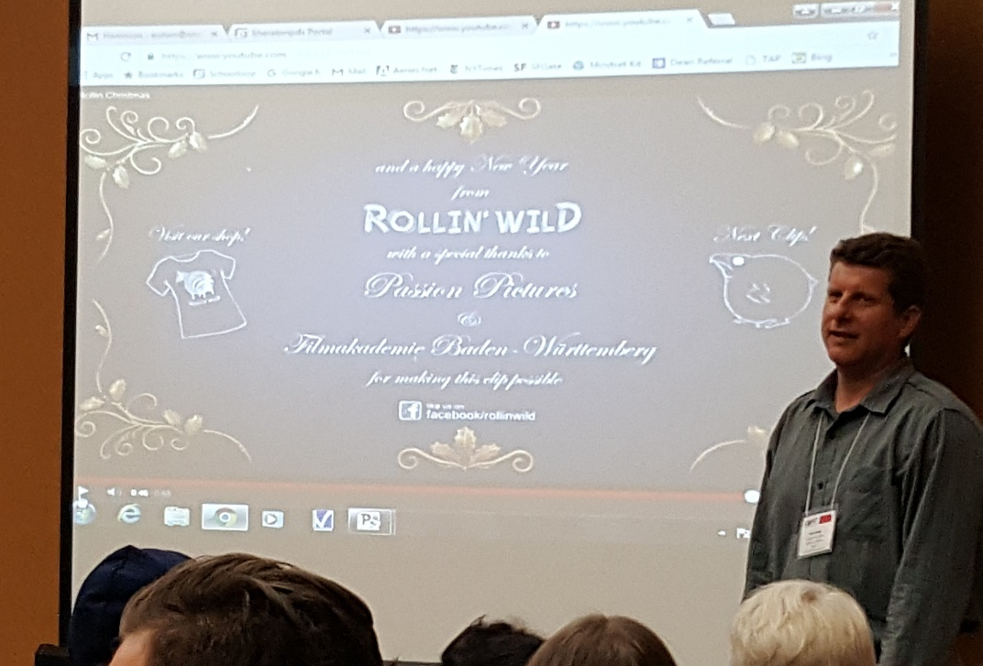
Movie Talk Leveraging Films and Clips For Comprehensible Input
Presentation given by Erik Olsen
He demonstrated how to use non-verbal short films/videos to tell a story 100% in the target languages
Films he used in the presentation were very funny & engaging!
Rollin Christmas - http://rollinwild.com/clips.php?v=6
The Paperless Future Emma - https://youtu.be/HHEYtw4IMpY - this is great for teaching topics like family, household items & going paperless

Slide 3
Some Short Animations I Really Like ☺
Piper First Look - https://youtu.be/u2N9NIpA0OE - it fits in theme related to animals and beach
Life in Shaolin Temple - https://youtu.be/EITn3tghVpY - it fits in theme for sports & hobbies
Dustin - https://youtu.be/P5yunhX3FIE - it fits in theme for family & pets
Pigeon Impossible - https://youtu.be/66AK8g-95wo
Presto - https://youtu.be/CB1Pukr0nFQ - it fits in theme related to pets or magic
Soar - https://youtu.be/UUlaseGrkLc
For the Birds – https://www.youtube.com/watch?v=2ncb5o5RLuA
It’s Smarter to Travel in Groups - https://youtu.be/FIlMhPhkoSA
Lifted - https://youtu.be/0Wj_mdBKmvw
Partly Cloudy - https://youtu.be/-FI9Gw58MdA
Clips from Rollin’ Wild - https://youtu.be/2ncb5o5RLuA
The Present - https://youtu.be/96kI8Mp1uOU - it has a surprising and touching ending ☺

Slide 4
Resources/Links for Movie Talks
https://martinabex.com/teacher-training/movietalk/ - Martina Bex
http://glesismore.com/movietalk/technique.html - Movie Talk website from Dr. Ashley Hastings
https://youtu.be/545NPhafQ5U - MovieTalk Demo by Martina Bex

Slide 5
Assess Something Real
Presentation given by Martina Bex
An amazing Spanish teacher from Alaska
World Languages Curriculum Consultant at the Comprehensible Classroom
Website https://martinabex.com/
Email martinaebex@gmail.com
Handouts she shared in conferences
https://martinabex.com/teacher-training/session-handouts/
https://martinabex.files.wordpress.com/2013/11/qar-actfl2015-handout1.pdf
https://martinabex.files.wordpress.com/2013/11/authres-detailed-handout.pdf
Activities she demoed or explained in the WAFLT 2016 conference are in the following pages

Slide 6
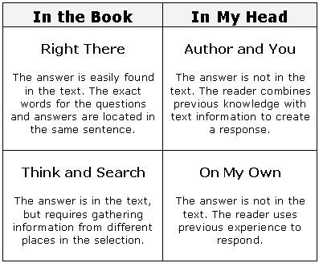
Questions-Answers Relationship (QAR)
QAR strategy presents a three-way relationship between questions, text content, and reader knowledge
It shows that students who understand how questions are written are better prepared to answer questions
These activities help students "demystify" the question-building process as a step toward better reading comprehension
It divides questions into two broad categories; "In the Book" (text-explicit) questions and "In My Head" (text-implicit) questions
"In the Book" questions are generated directly from a reading selection
These explicit questions fall into two subcategories: "Right There"–questions found in one place in a selection and "Think and Search"–questions built around cumulative information found throughout a document.
"In My Head" questions are created by the reader when confronting a text. These questions are not explicitly found in the reading; rather, these questions arise as the reader engages the selection's content through active thought, comparison, evaluation, etc.
These implicit questions fall into two subcategories: "Author and You"–questions that the text provokes in the reader and "On My Own"–questions arising from the reader's prior knowledge and experiences
Example of QAF in English - http://www.readingquest.org/strat/qar.html

Slide 7
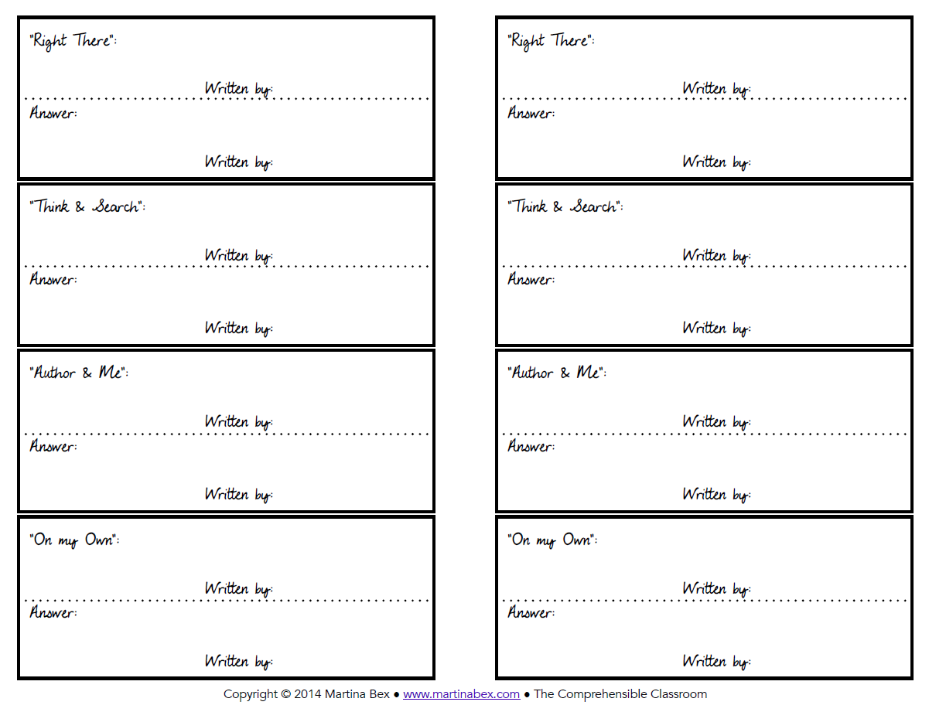
Grab & Go
Form go with QAR activities
https://martinabex.files.wordpress.com/2013/04/agarrapregunta-qar.pdf

Slide 8
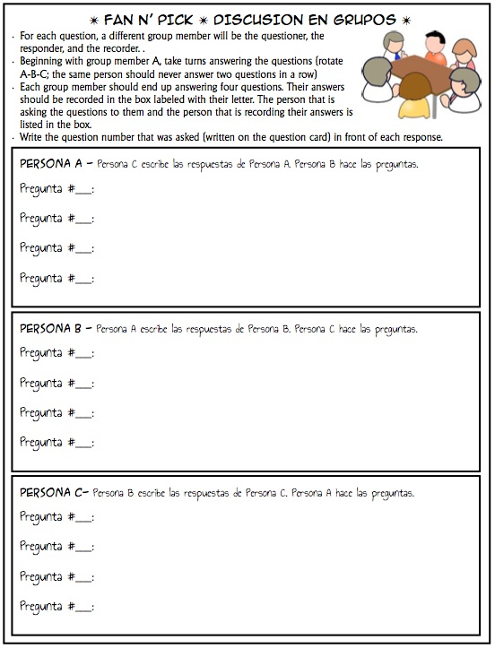
Fan-N-Pick
A cooperative comprehension activity
Three people in a group
For each question, one member in the group is the questioner, the responder, and the recorder

Slide 9
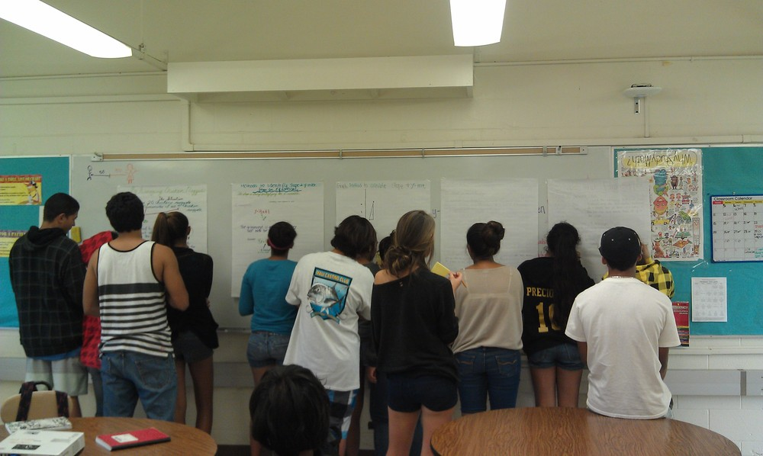
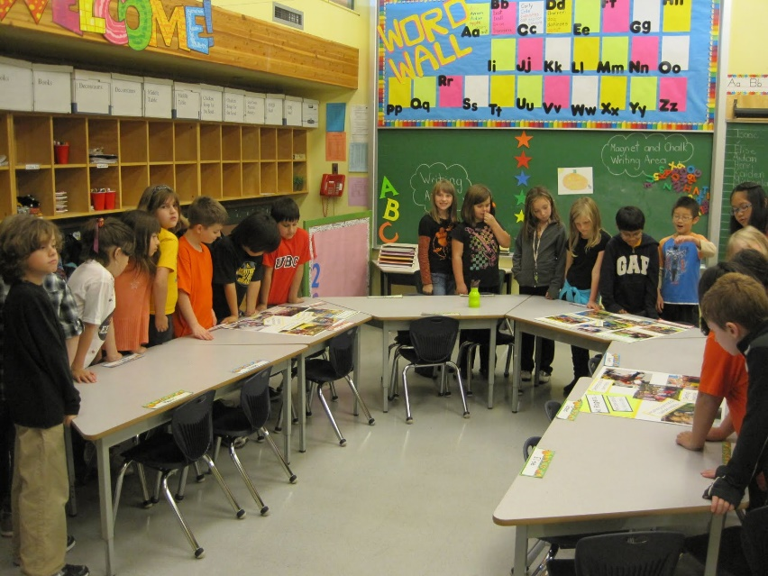
Gallery Walk
An activities to create discussion
https://martinabex.com/2013/10/07/gallery-walk/
I use Gallery Walk a lot myself – students love it! ☺

Slide 10
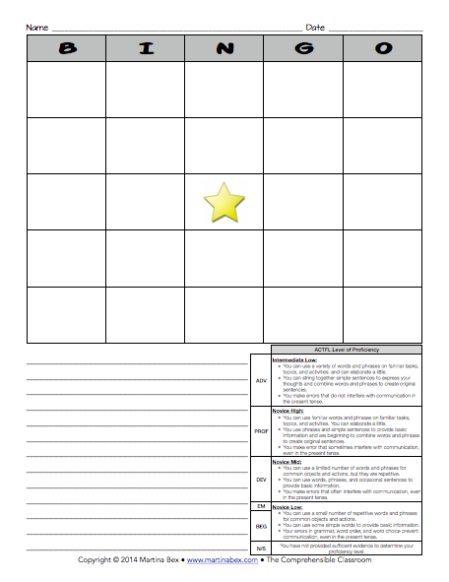
Bingo Free Write
Play BINGO with your students, then ask them to choose one row of their words and use the five words that it contains in a free write
Download the form from Teachers Pay Teachers
https://www.teacherspayteachers.com/Product/Writing-Activity-BINGO-with-writing-extension-and-rubric-322794
Six different rubrics are included
Both a PDF and an editable .doc version of the file are included

Slide 11
1-3-10 Free Write
A scaffolded writing activity created by Martina Bex
How to use the form
https://martinabex.com/2011/10/11/1-3-10-free-write/
Download the form from Teachers Pay Teachers
https://www.teacherspayteachers.com/Product/Writing-Activity-1-3-10-Free-Write-335679

Slide 12
Thank you!
For questions, more details and video clips for the presentations, please contact Sarah Yao @ yao.sarah@gmail.com

